Slide 1

Recommendation System of News Based on Impression Logs
Presented by: Luna Zhu, Jure Sindi, Xuan Wu

Slide 2
The Problem
The problem that we are aiming to study in this project is identifying biases in news recommendation algorithms, such as overexposure to certain topics or underrepresentation of others, and developing methods to mitigate these biases.

Slide 3
Motivation and Importance
News recommendation systems are an important technology that helps users find news content that they are interested in and reduce information overload. But there are challenges and biases associated with news recommendation algorithms that have motivated us to explore:
Diversity
Fairness
Impact on the user’s behavior
Researching these biases in news recommendation algorithms is important to ensure that these systems provide users with high-quality and diverse news experiences.

Slide 4
Literature Review
The literature on bias in recommendation systems, particularly in the domain of news recommendation algorithms, highlights the importance of addressing bias. Previous research has identified various types of biases inherent in recommendation algorithms, including algorithmic bias, personalization bias, and content bias.
Diversity analysis has emerged as a common approach for identifying biases in recommendation systems. And fairness-aware recommendation frameworks have been proposed to mitigate biases and ensure equitable content distribution across user demographics.

Slide 5
Literature Review Cont.
Our focus is on identifying biases in news recommendation algorithms using the MIND: Microsoft News Dataset, such as overexposure to certain topics or the underrepresentation of other topics, and developing effective methods to mitigate said biases.
In the context of news recommendation algorithms, our research is focused on leveraging the large-scale dataset MIND: Microsoft News Dataset.
By incorporating user history, news embeddings, and attention mechanisms from the MIND dataset, the DKN algorithm aims to provide personalized recommendations while mitigating biases associated with topic overexposure and underrepresentation.

Slide 6
Proposed Approach
Deep Knowledge-aware Network
Knowledge distillation
Knowledge-aware CNN
Gated Recurrent Unit (GRU)

Slide 7
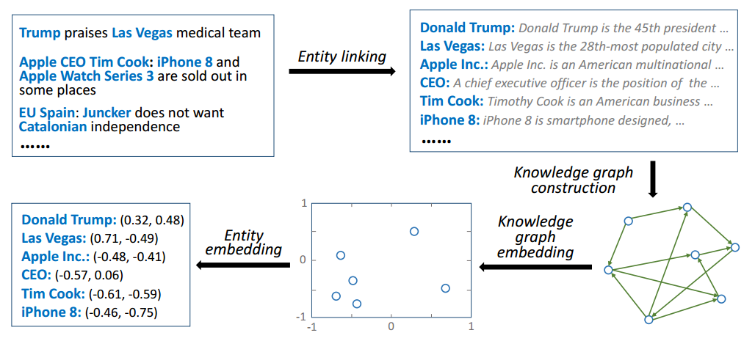
Proposed Approach
Deep Knowledge-aware Network
Knowledge distillation

Slide 8
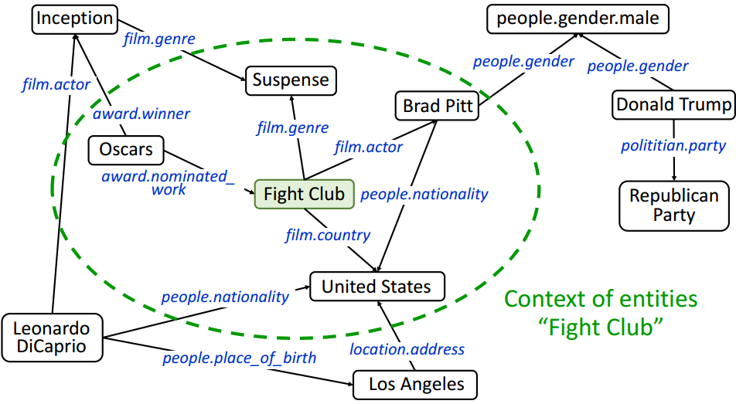
Proposed Approach
Deep Knowledge-aware Network
Knowledge distillation
Google Satori

Slide 9
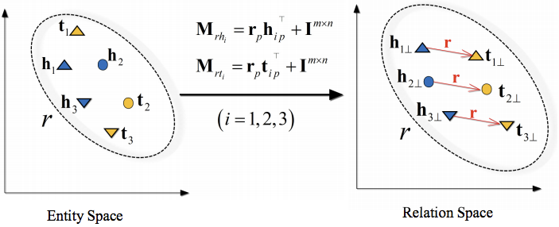
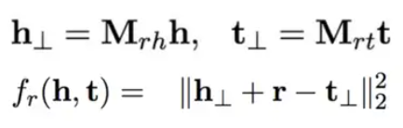
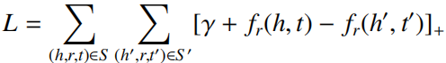
Proposed Approach
Deep Knowledge-aware Network
Knowledge distillation
TransD

Slide 10
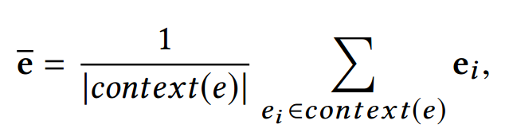
Proposed Approach
Deep Knowledge-aware Network
Knowledge distillation
context embedding: the average of its contextual entities

Slide 11
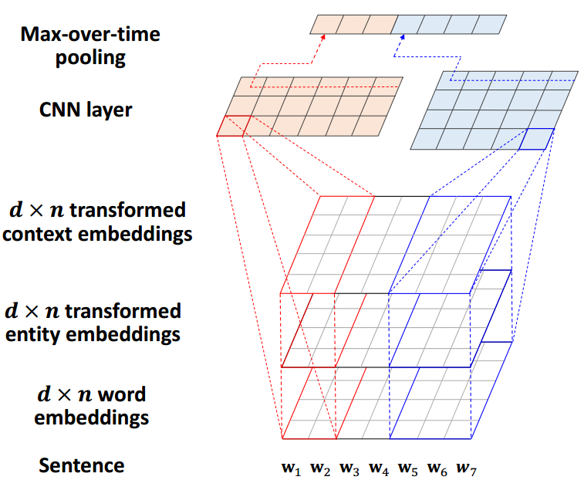


Proposed Approach
Deep Knowledge-aware Network
Knowledge-aware CNN

Slide 12
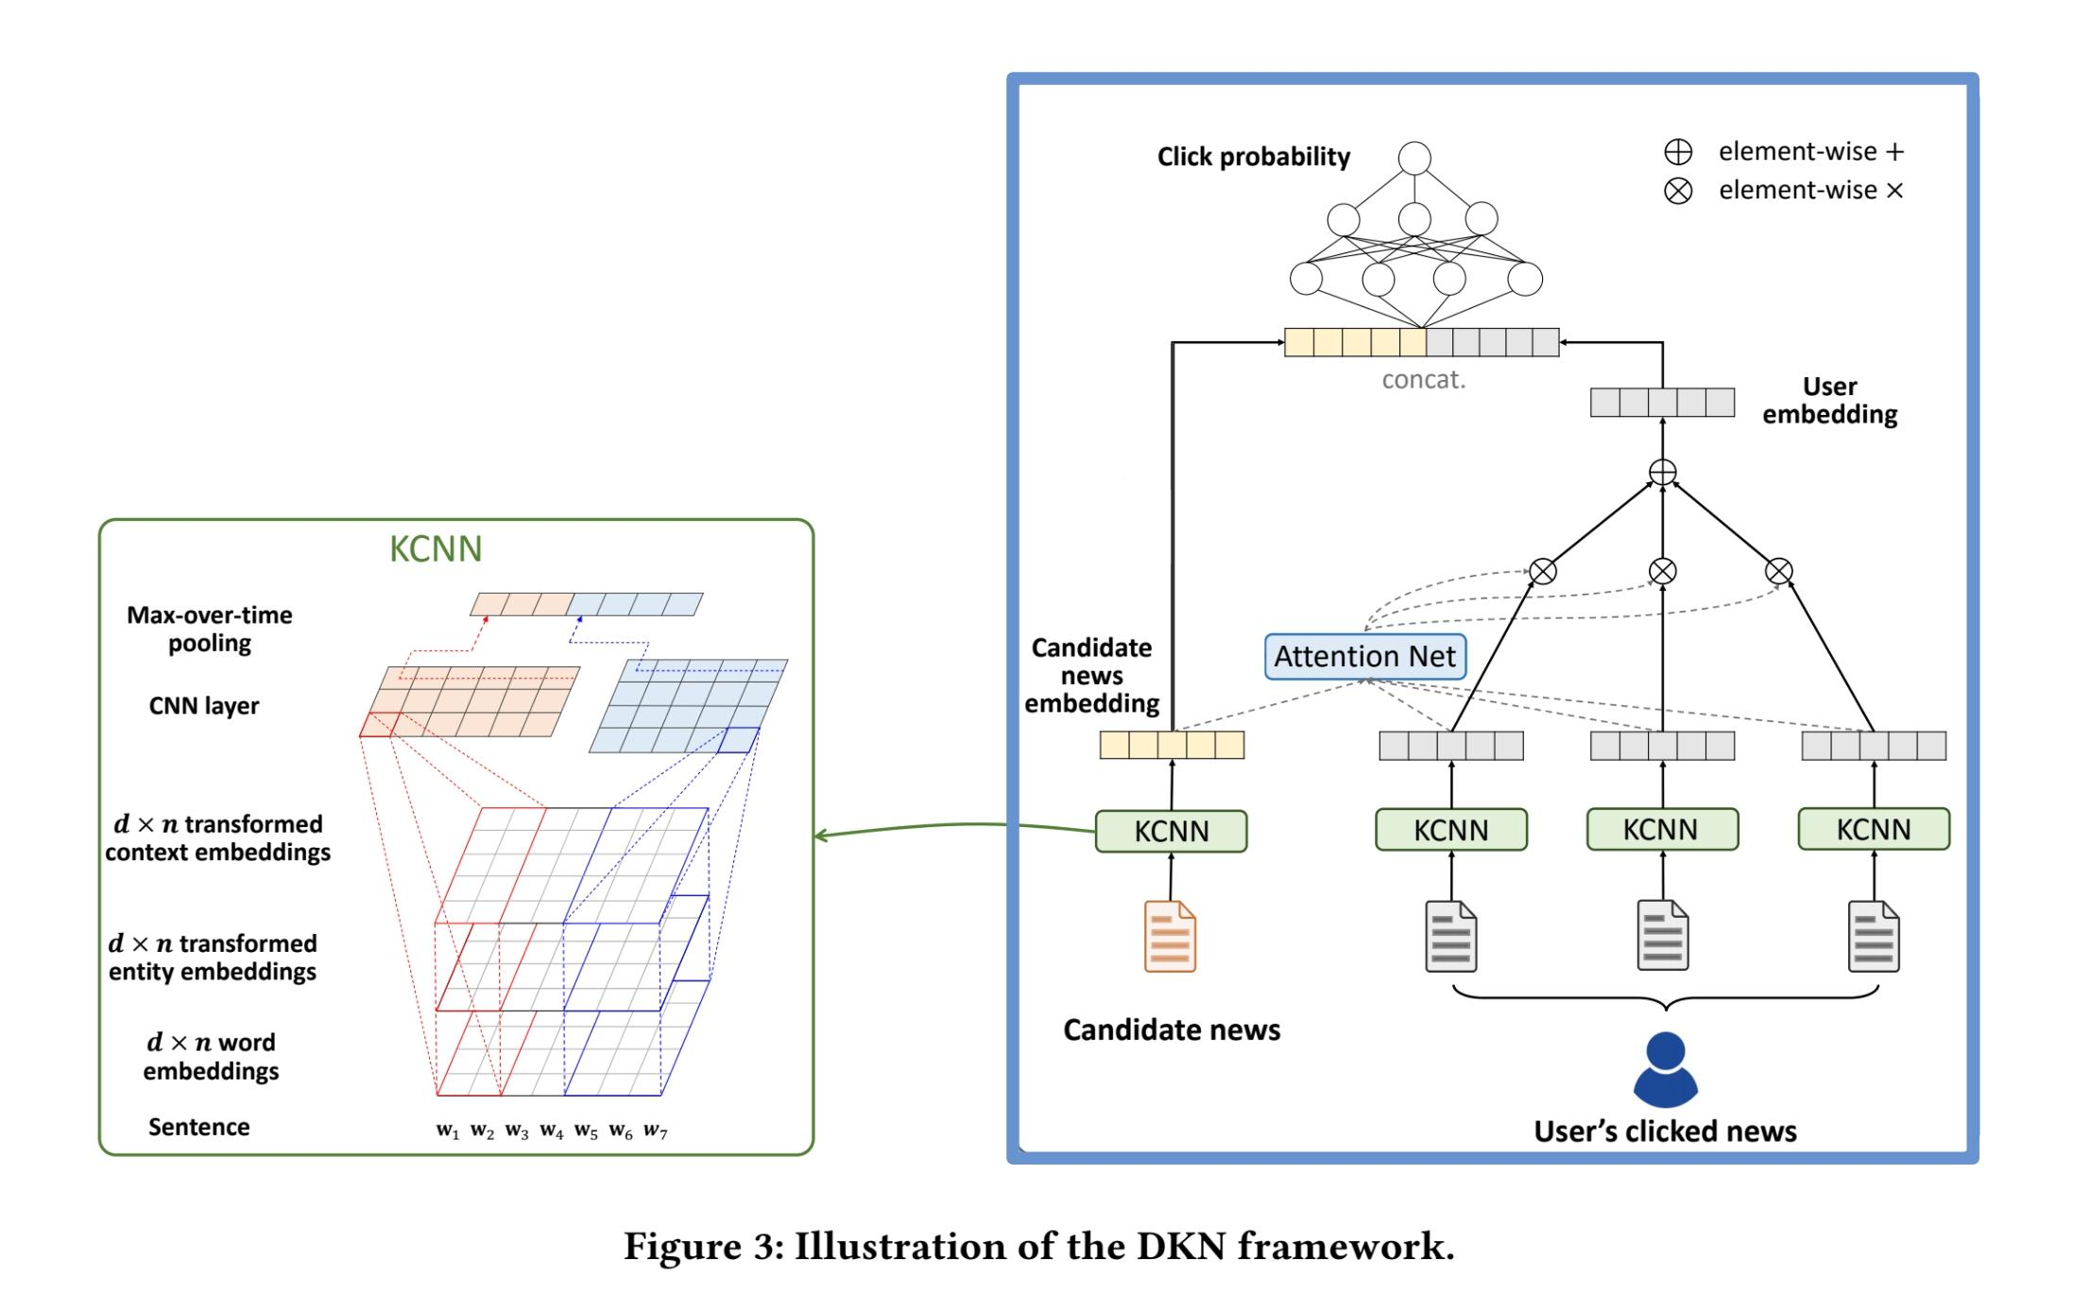
Proposed Approach
Deep Knowledge-aware Network

Slide 13
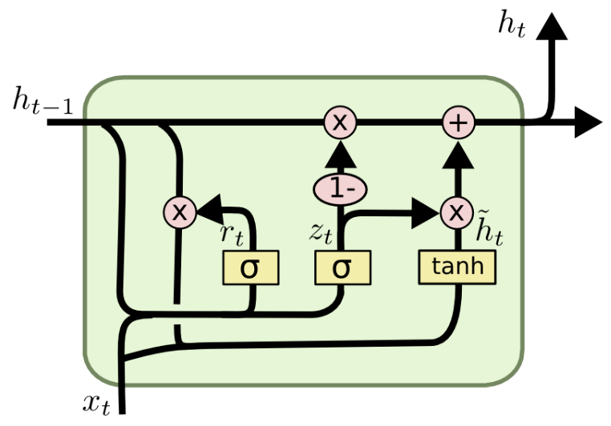
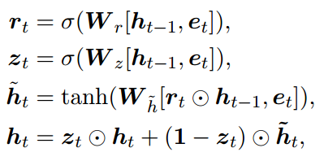
Proposed Approach
Gated Recurrent Unit (GRU)
←Reset gate
← Update gate
← Candidate Activation
← Final Hidden State

Slide 14
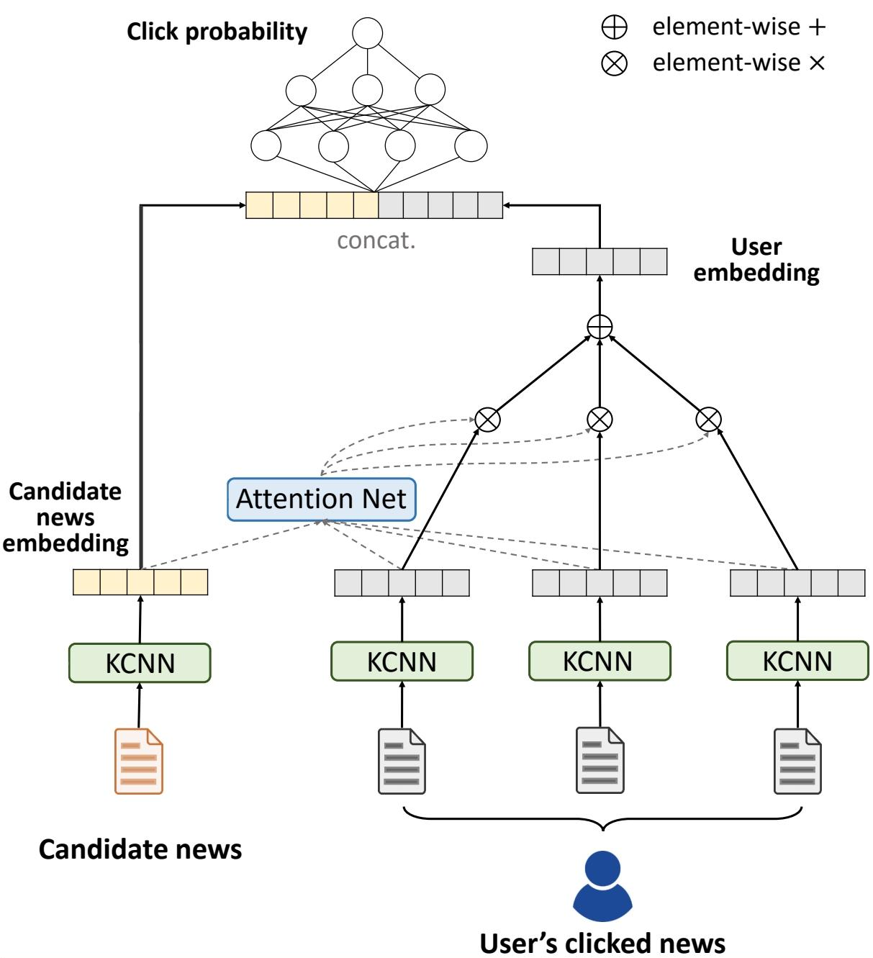
Proposed Approach
…
GRU
GRU
GRU

Slide 15
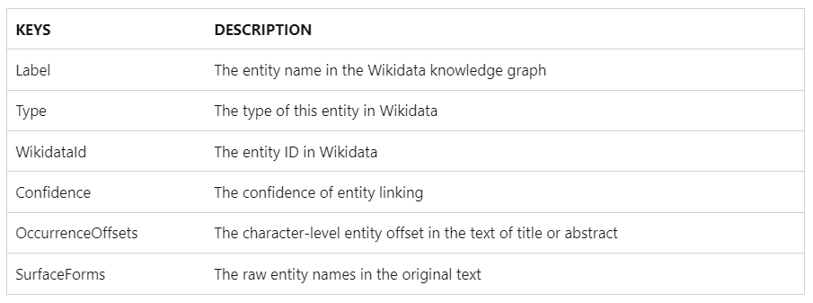
Data Description
Microsoft News Dataset (MIND)
Source: Anonymized logs from Microsoft News.
Articles: ~160k English news articles.

Slide 16
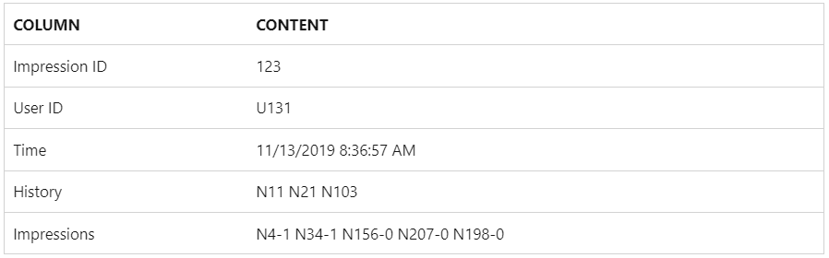
Data Description
Microsoft News Dataset (MIND)
Source: Anonymized logs from Microsoft News.
User Interactions: 15M+ logs from 1M users.

Slide 17
Analysis of Results
Output: rankings of click probability of news in impression
Building news type distributions
Compare news type distributions
(a) Actual user engagement vs. recommender-ranked exposure
(b) Measure of similarity: Jensen-Shannon Divergence
Diversity Analysis
User-wise Gini coefficient
User-wise Entropy

Slide 18
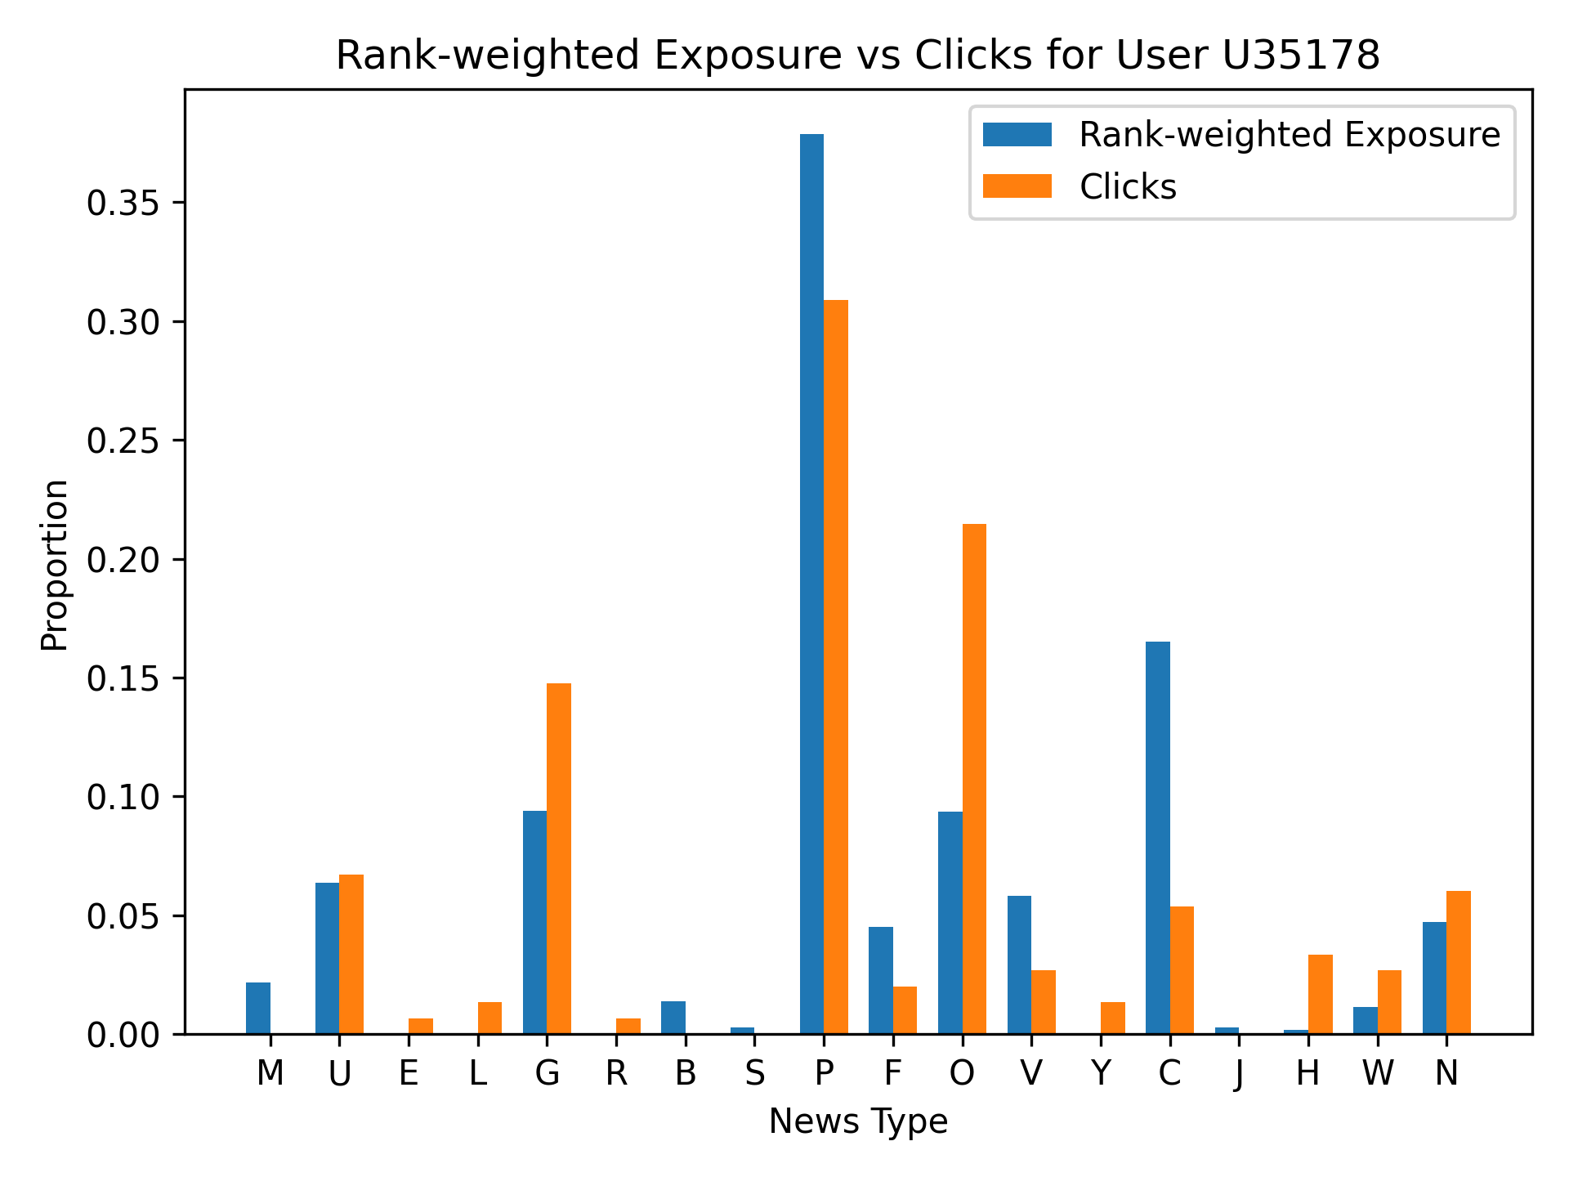
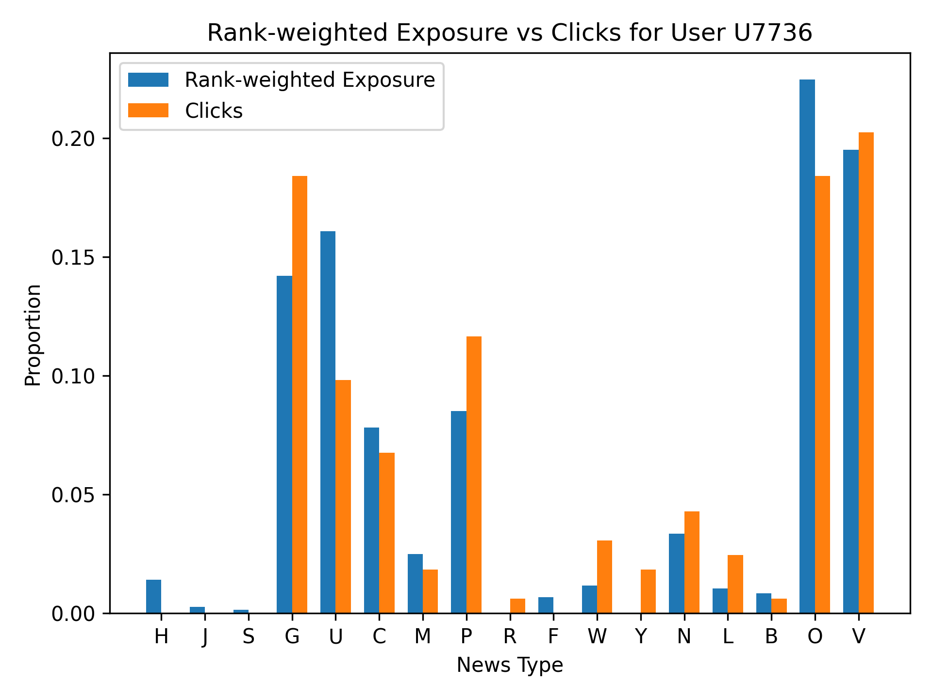
Individual Exposure vs. Clicks Analysis
Compares the proportion of news type exposures to clicks
– Single user

Slide 19
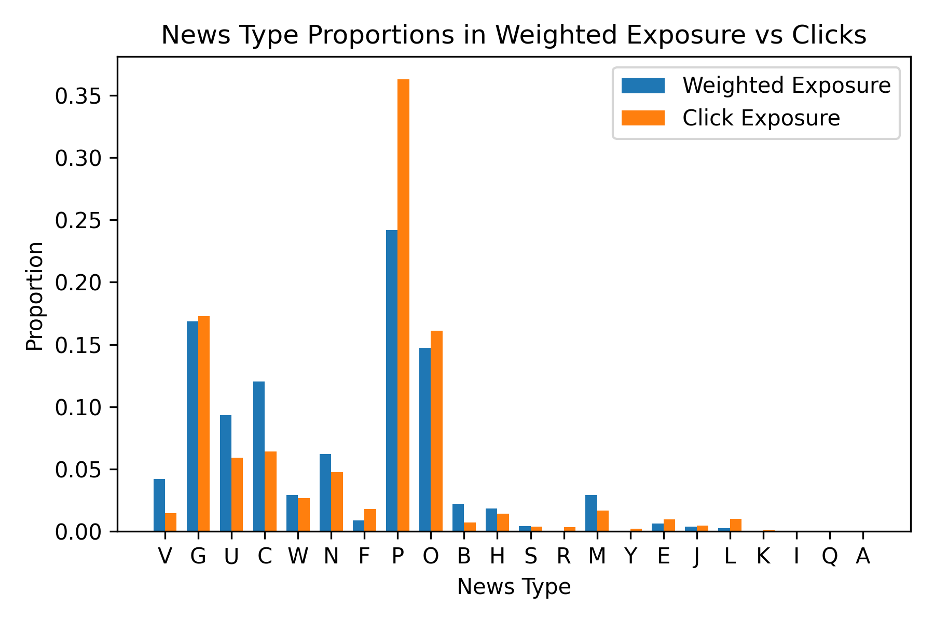
Overall Exposure vs. Clicks Disparity
Compares the proportion of news type exposures to clicks
– Across all users

Slide 20
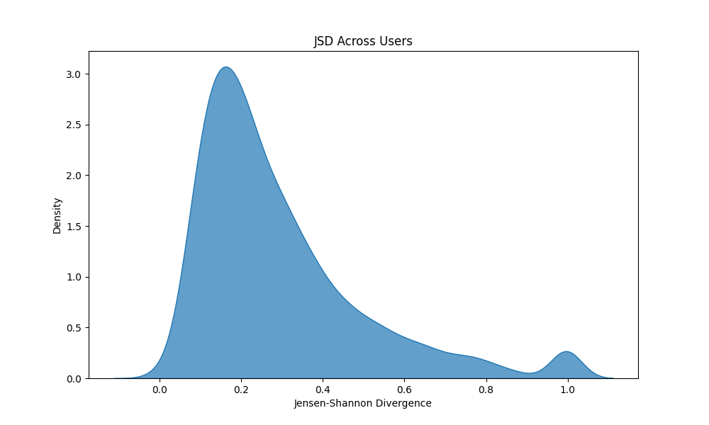
Similarity between type distributions
Use JSD to evaluate how well the rank-based news type distribution in impressions
aligns with that reflected by user clicks
Lower JSD
is better

Slide 21
Diversity Analysis
Metrics
Gini coefficient : measures how concentrated the exposure to news types is
Low Gini a more equitable distribution across different types
Entropy: assess how varied the types of news are
High entropy a high level of diversity

Slide 22
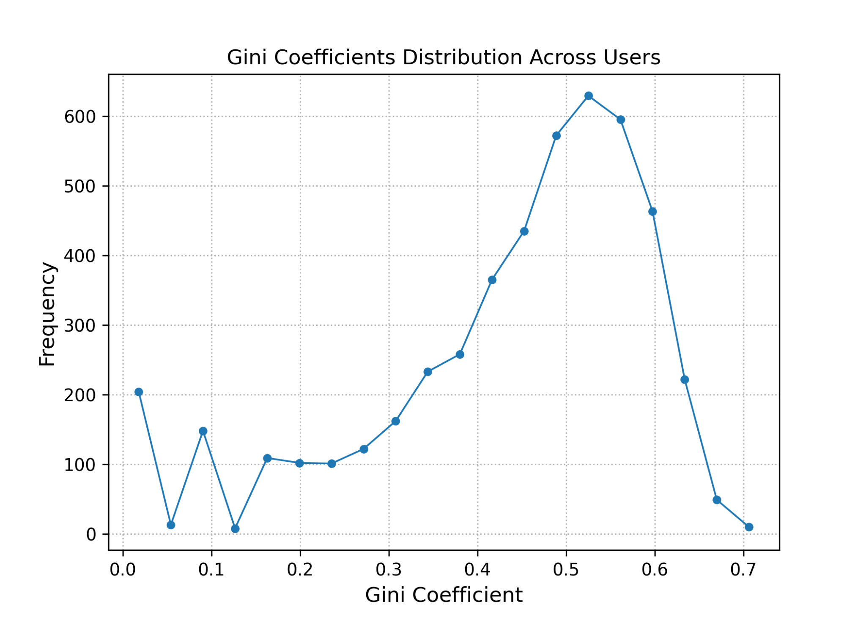
Distribution inequality of news types among rank-weighted news exposures
Gini coefficient distribution across all users

Slide 23
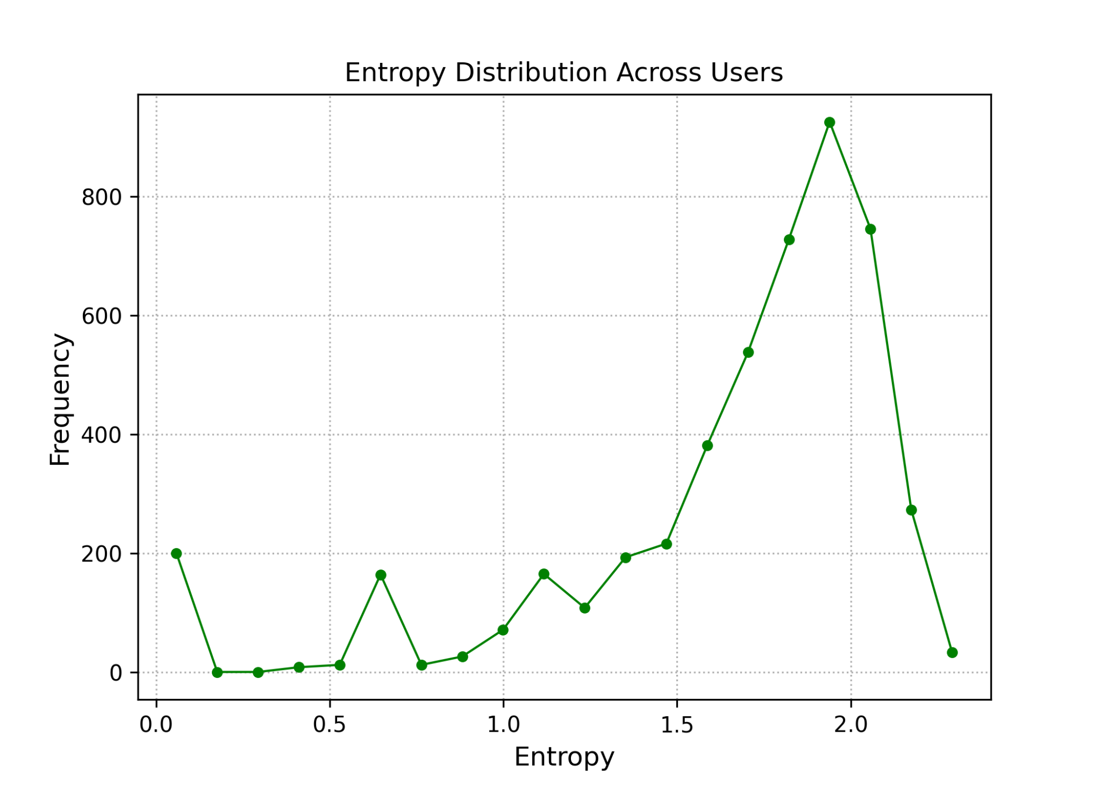
Diversity of news types in the rank-weighted news exposures
Entropy distribution across all users

Slide 24
Conclusion
metrics for evaluating the similarity of news type distributions between actual user
engagement and exposures
metrics for evaluating the diversity and equity of distribution of news types

Slide 25
Future Works
Achieving algorithmic fairness and diversity
Considering the influence of human actions
Test on a larger dataset and compare the results with the current results

Slide 26
Questions?

